Slide 1
Marianna Zhang
Structural representations of categories
and why we should care
Markman lab meeting
1.25.2021
Notes:
Project update on structural consequences
Since I’ve previously presented this project, I’ll speed pretty quickly through the background, but please jump in w questions or if I’m moving too quickly
A mixed bag of data, would love feedback on how to interpret and where to go next

Slide 2
Why group differences?
Northern Chinese & noodles
Southern Chinese & rice
(climate for growing rice vs wheat)
Japan, Guangdong, New England & seafood (proximity to ocean)
racial minorities in the US & unhealthy foods (food deserts)
foodways
religious groups & food restrictions (halal, kosher…)
East Asian people & lactose intolerance (LCT gene for lactase)
“Our bodies best digest…” (folk biology)
biology
culture
(shared beliefs/values)
structural
(external constraints: eg access/availability)
group diet
Notes:
cuisines develop & adapt to local ecology and resources

Slide 3
Why group differences?
Sherpa people & mountaineering (more hemoglobin)
Japanese women & pearl fishing (more body fat)
women & factory work (“nimble fingers”, “detail-oriented”, docile)
men & tech (“smarter”)
Black people & sports (“stronger”)
Asians & math
(math drills, families value math)
Chinese people & martial arts
(Orientialism, exoticism)
POC & essential workers (language barrier, limited resources, stereotyping, economic discrimination)
biology
culture
(shared beliefs/values)
structural
(external constraints: eg discrimination, opportunity)
occupation
Notes:
Some of these are historical narratives used to limit the opportunities of certain groups, push them into particular occupations

Slide 4
What we take to the be cause of group differences really matters.

Slide 5
inputs
essentialism
biology
culture
(shared beliefs/values among group)
structural
(constraints on group external to group: eg access/availability)
group property
consequences
Notes:
Zoom out a bit to the theory here:
Biology as paradigmatic case of essentialism: something inherent within each group member that makes them what they are, and that causally produces notable group properties
Inputs to essentialism, and many problematic consequences of essentialism
Cultural as also potentially a form of essentialism (Bailey et al)

Slide 6
inputs
essentialism
biology
culture
(shared beliefs/values among group)
structural
(constraints on group external to group: eg access/availability)
group property
- wide group-based generalizations (stereotyping)
- increased perceived differences between groups
- reduced blame for immoral behavior
- justifies properties as natural and normative
- …

Slide 7
inputs
essentialism
(Bailey et al, 2020)
biology
culture
(shared beliefs/values among group)
structural
(constraints on group external to group: eg access/availability)
- reduced blame for immoral behavior
group property
- wide group-based generalizations (stereotyping)
- context-based generalizations (Vasilyeva et al, 2019/2020)
- increased perceived differences between groups?
- justifies properties as natural and normative?
Notes:
Bailey et al have argued to extend essentialism etc
“culture of poverty”

Slide 8
Why does it matter which of these causes we attribute group properties/differences to?
essentialism
(Bailey et al, 2020)
Why is this construal better?
How are these similar or different?
biology
culture
(shared beliefs/values among group)
structural
(constraints on group external to group: eg access/availability)
- reduced blame for immoral behavior
group property
- wide group-based generalizations (stereotyping)
- context-based generalizations (Vasilyeva et al, 2019/2020)
- increased perceived differences between groups?
- justifies properties as natural and normative?
Notes:
Why does it matter?
Will involve fleshing out the consequences of these different construals
How do these construals lead to different consequences? In particular, 1) why is the structural construal better, something we should try to promote?
2) Understand the ways in which biological and cultural construals are similar or different

Slide 9
Why does it matter which of these causes we attribute group properties/differences to?
essentialism
(Bailey et al, 2020)
biology
culture
(shared beliefs/values among group)
structural
(constraints on group external to group: eg access/availability)
group property
Initial set of consequences tested:
How we generalize (what we think is the case)
What could be the case
What should be the case
How to change what is the case

Slide 10
Why does it matter which of these causes we attribute group properties/differences to?
essentialism
(Bailey et al, 2020)
biology
culture
(shared beliefs/values among group)
structural
(constraints on group external to group: eg access/availability)
group property
Initial set of consequences tested:
Generalization
Possibility of change
Normativity
Target of intervention
Notes:
General logic: induce one of these three construals, measure various consequences

Slide 11
Study 1: diet
adults (complete)
children (running 5-8yo)

Slide 12
Why group differences?
Northern Chinese & noodles
Southern Chinese & rice
(climate for growing rice vs wheat)
Japan, Guangdong, New England & seafood (proximity to ocean)
racial minorities in the US & unhealthy foods (food deserts)
foodways
religious groups & food restrictions (halal, kosher…)
East Asian people & lactose intolerance (LCT gene for lactase)
“Our bodies best digest…” (folk biology)
biology
culture
(shared beliefs/values)
structural
(environmental availability)
group diet
Notes:
Return to causes of group diets

Slide 13
allergies / intolerance
taboo food restrictions
what grows where
biology
culture
(shared beliefs/values)
structural
(environmental availability)
group diet
Notes:
Distill down to

Slide 14

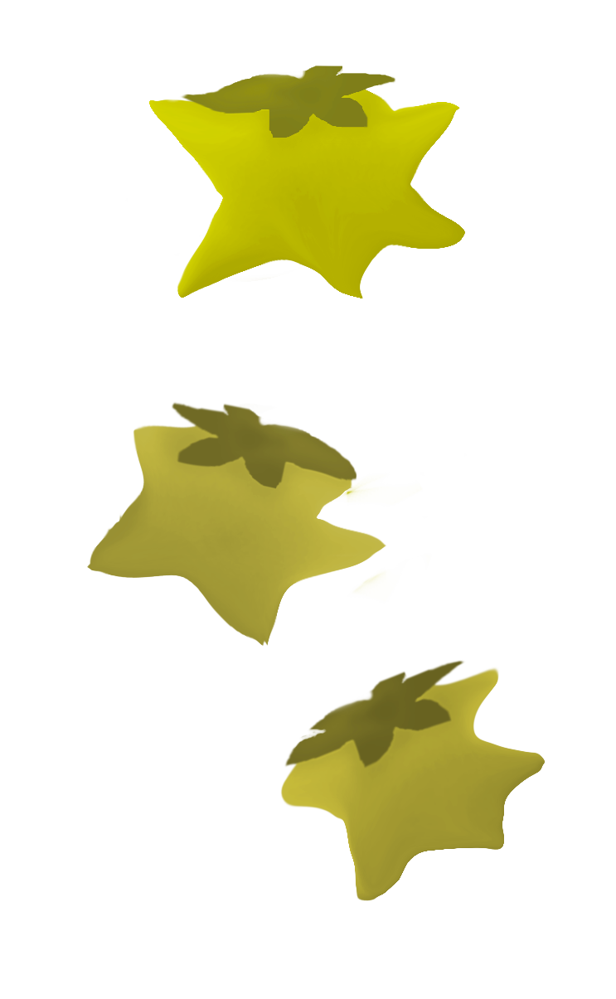
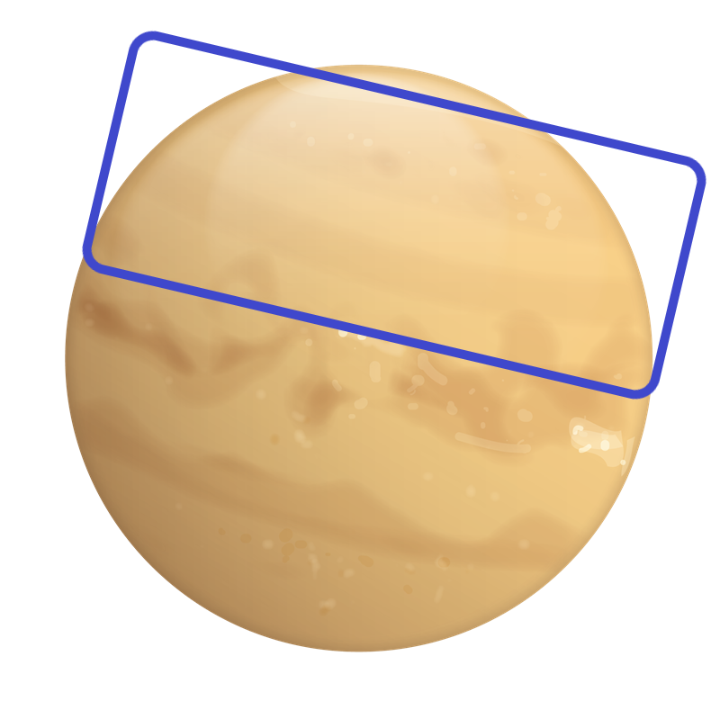
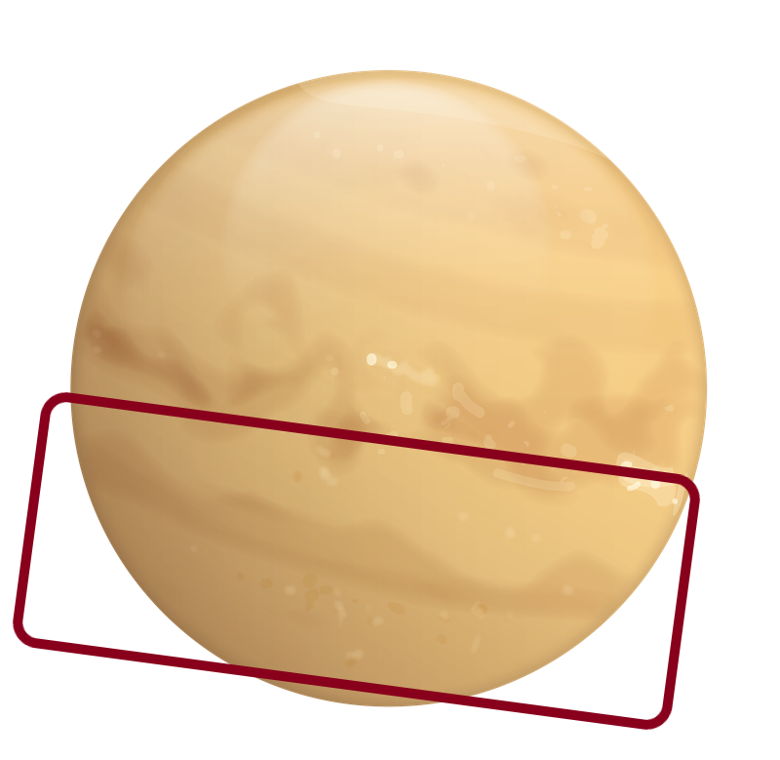
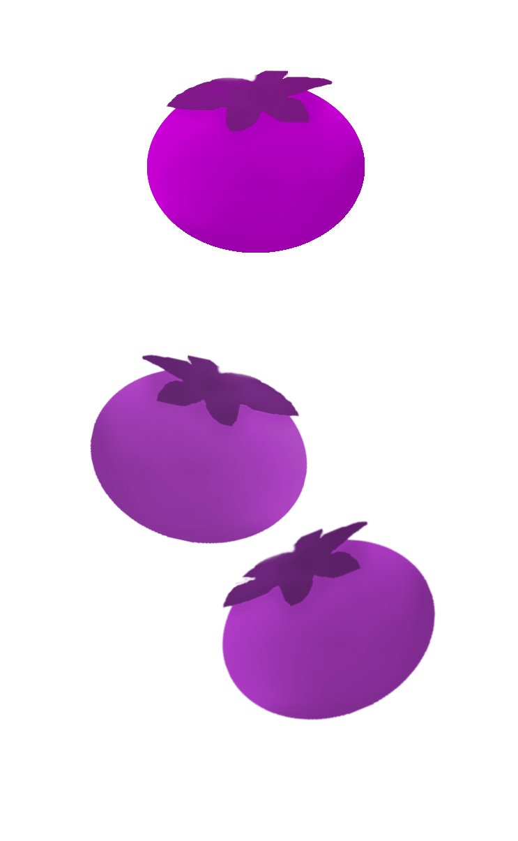

Zarpies live on this side of the planet… Vawns live on the other side of the planet.
Zarpies eat starberries. Vawns eat roundberries.
Because of the way their bodies work, other berries make them sick, so …
Because starberries are the only berries that grow in the area where they live, …
Because they believe eating other berries is bad luck, …
allergies / intolerance
taboo food restrictions
what grows where
biology
culture
(shared beliefs/values)
structural
(environmental availability)
group diet
…Zarpies eat starberries.
adults (n=167, ~55/condition on MTurk)
children (5-8yo via online testing)
Notes:
cuisines develop & adapt to local ecology and resources

Slide 15
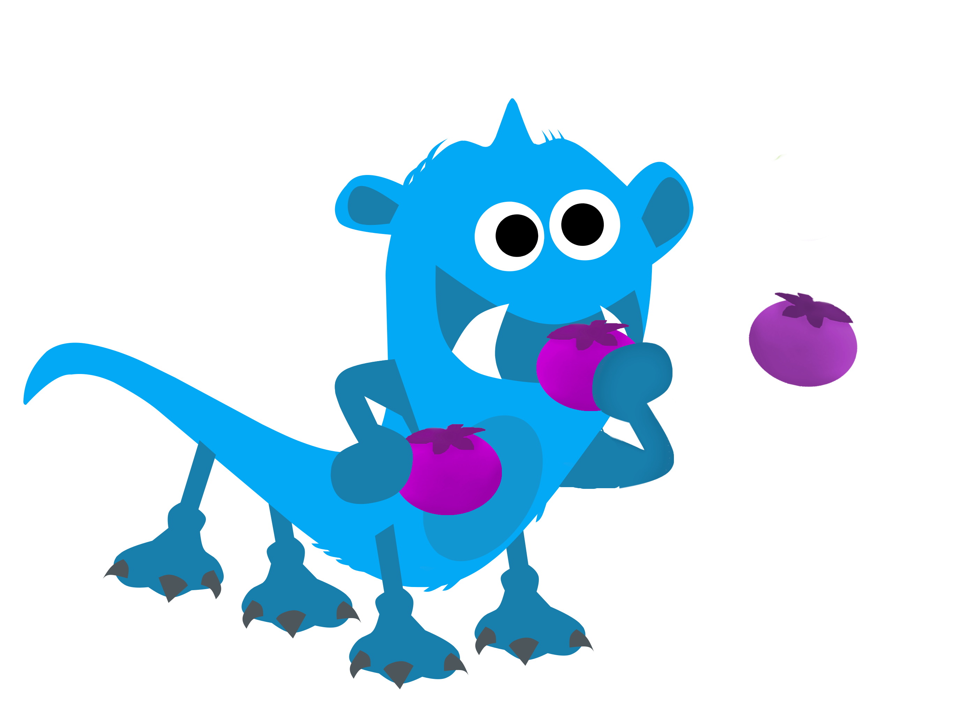
What are the consequences of different construals of group diet?
Possibility of change (gender stereotyping)
Possible for Zarpies to have a different diet?
Which group usually eats roundberries? (Vawns)
Can Zarpies also eat roundberries? (y/n x for sure/maybe)
biological ~ cultural < structural
Normativity (Roberts et al., 2016)
Disapprove if a Zarpie had a different diet?
Look, here is a Zarpie who eats roundberries!
Is it okay or not okay for this Zarpie to eat roundberries?
biological > cultural > structural
?
Generalization (switched context from essentialism)
Expect a Zarpie outside of the structural context to share the same diet?
Look, here's another Zarpie… lives on the other side of the planet. Which berries do you think this Zarpie eats?
biological > cultural > structural
Target of intervention
starberry harvest failed / storm destroyed starberries this year. Zarpies need to eat roundberries. If you could make anything happen, what would you/be best do, so that the Zarpies can eat roundberries?
biological : Zarpies’ biology
cultural: Zarpies’ culture
structural: berry availability
?
adults (n=167 on MTurk)
children (5-8yo via online testing)
Notes:
cuisines develop & adapt to local ecology and resources

Slide 16
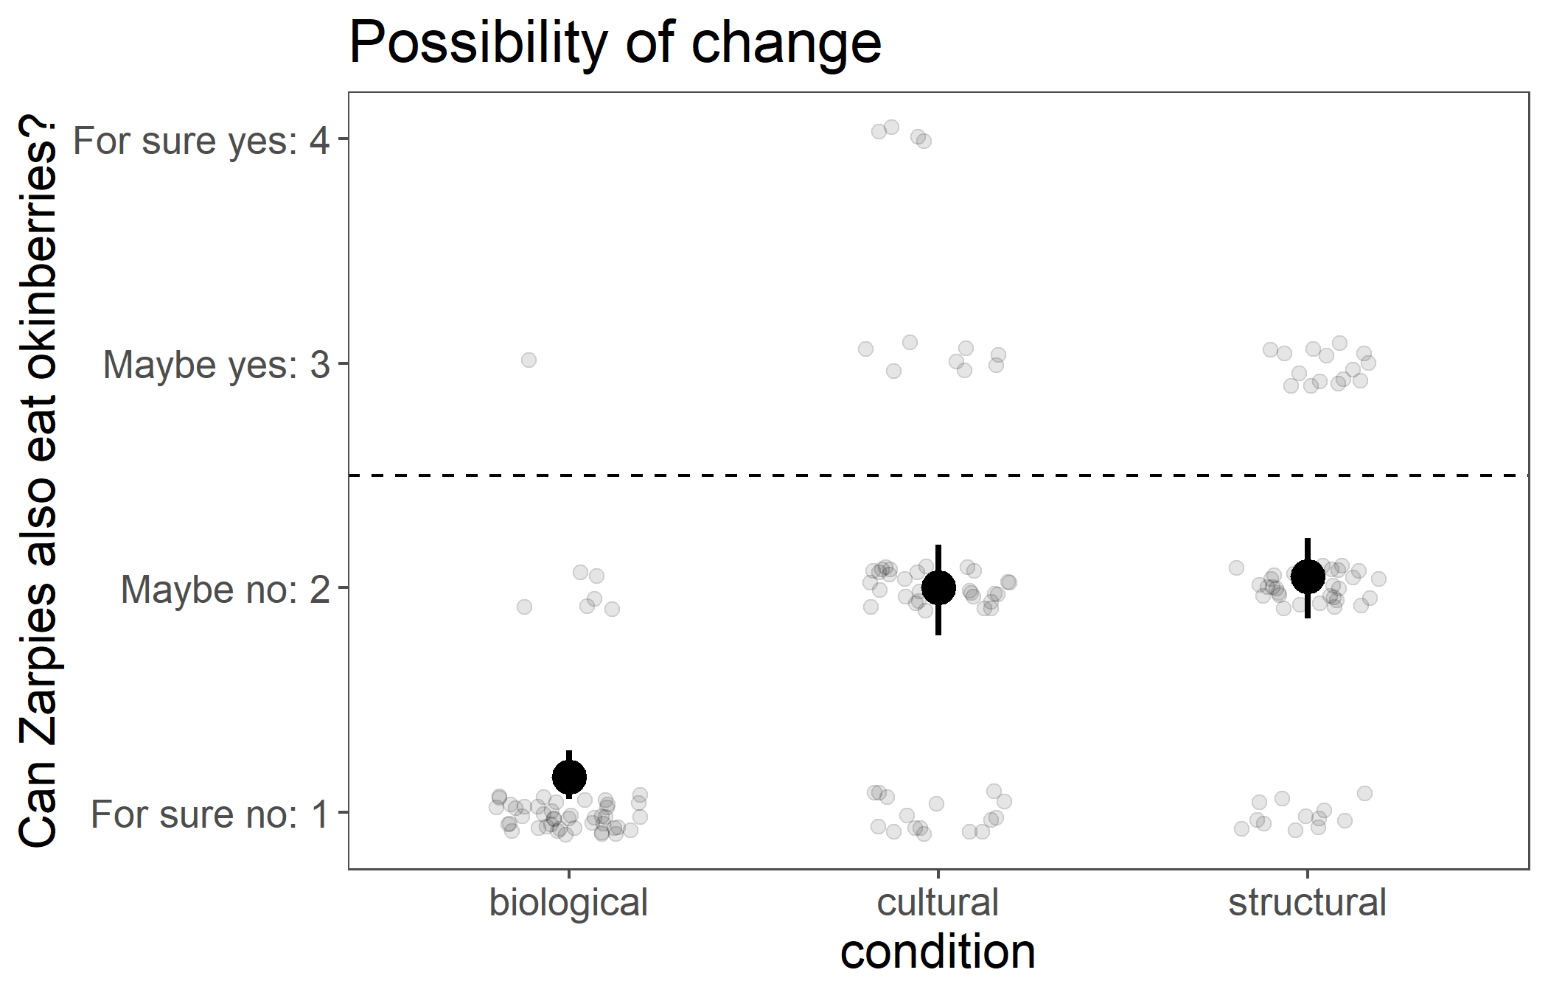
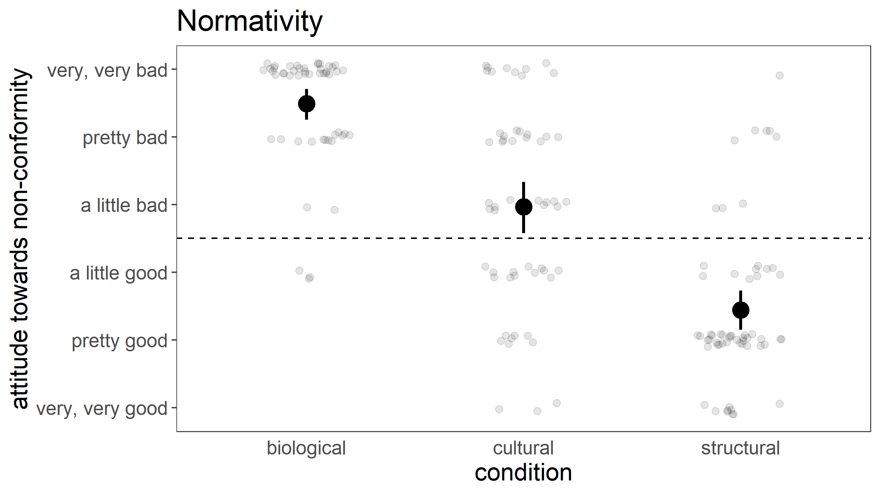
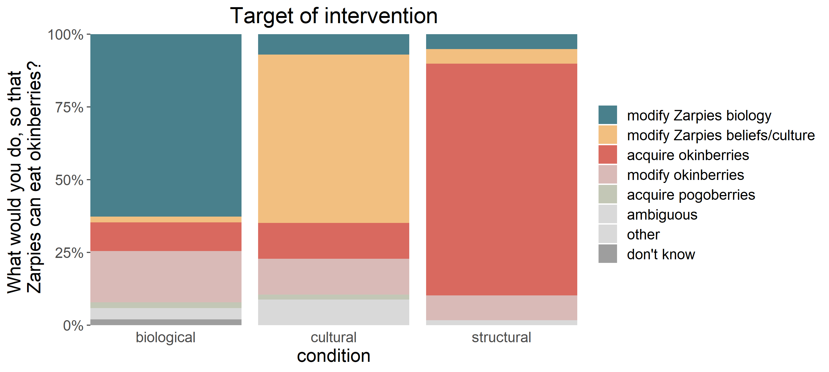
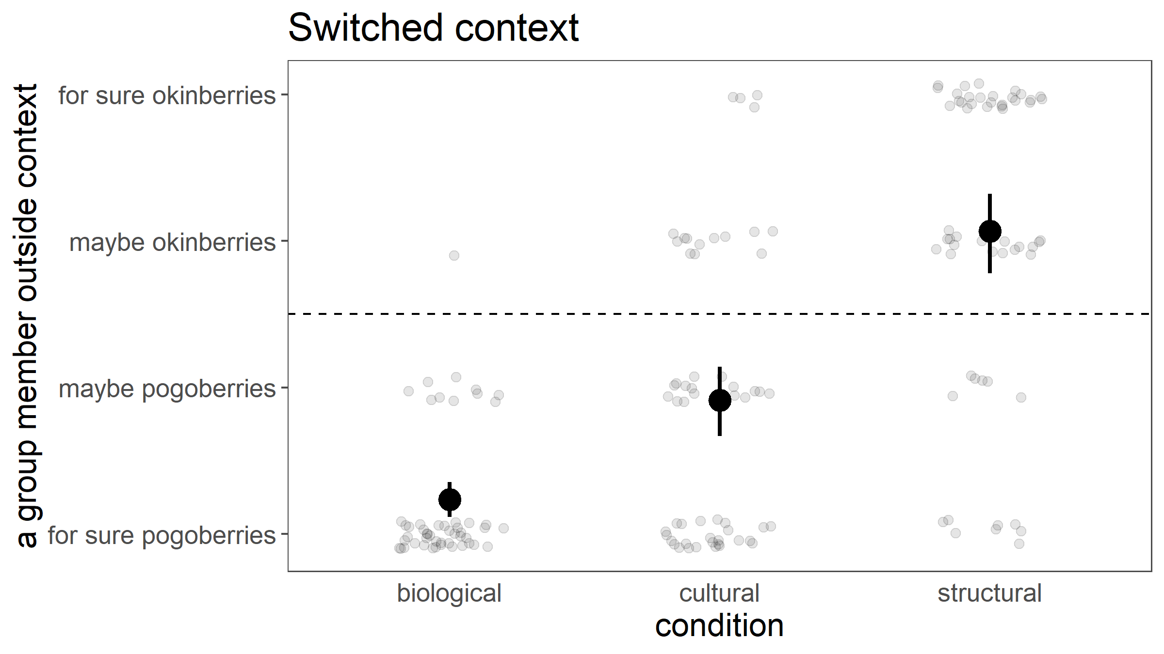
What are the consequences of different construals of group diet?
Notes:
Fixed order

Slide 17
Structural construals lead to…
greater possibility that the group could change
less negative feelings about a group member acting differently
context-based generalization rather than group-based
interventions targeting context rather than the group
Notes:
Similar results in pilot studies with 5-8yo

Slide 18
Why does it matter which of these causes we attribute group properties/differences to?
essentialism
(Bailey et al, 2020)
biology
culture
(shared beliefs/values among group)
structural
(constraints on group external to group: eg access/availability)
group property
Initial set of consequences tested:
How we generalize (what we think is the case)
What could be the case
What should be the case
How to change what is the case

Slide 19
Study 2: occupation
adults
3 sets of pilot studies
Notes:
Hierarchical context

Slide 20
Why group differences?
Sherpa people & mountaineering (more hemoglobin)
Japanese women & pearl fishing (more body fat)
women & factory work (“nimble fingers”, “detail-oriented”, docile)
men & tech (“smarter”)
Black people & sports (“stronger”)
Chinese-Americans & restaurants
Latino men & farm workers
Latina women & domestic workers
POC & essential workers (language barrier, limited resources, stereotyping, economic discrimination)
(social networks, weak ties)
Asians & math
(math drills, families value math)
Chinese people & martial arts
(Orientialism, exoticism)
biology
culture
(shared beliefs/values)
structural
(external constraints: eg discrimination, opportunity)
occupation
Notes:
Some of these are historical narratives used to limit the opportunities of certain groups, push them into particular occupations

Slide 21
bodies are physically well-suited
group’s values and traditions are well-suited
constraints on employment opportunities (discrimination)
biology
culture
(shared beliefs/values)
structural
(constraints external to group)
occupation
adults (n=16-20/condition on MTurk)
Notes:
3 sets of pilots: walk you through the first 2 pilot studies (16-20/condition on Mturk), since methods and results are very similar, and then take you to the newest pilot

Slide 22
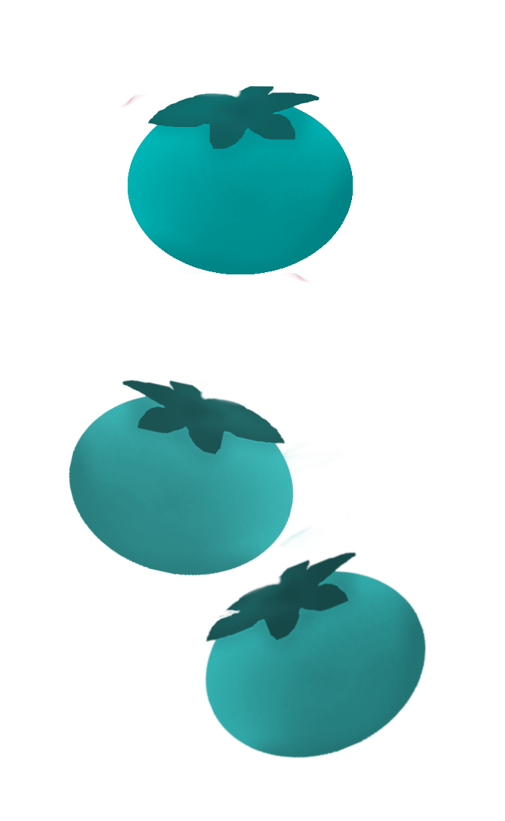

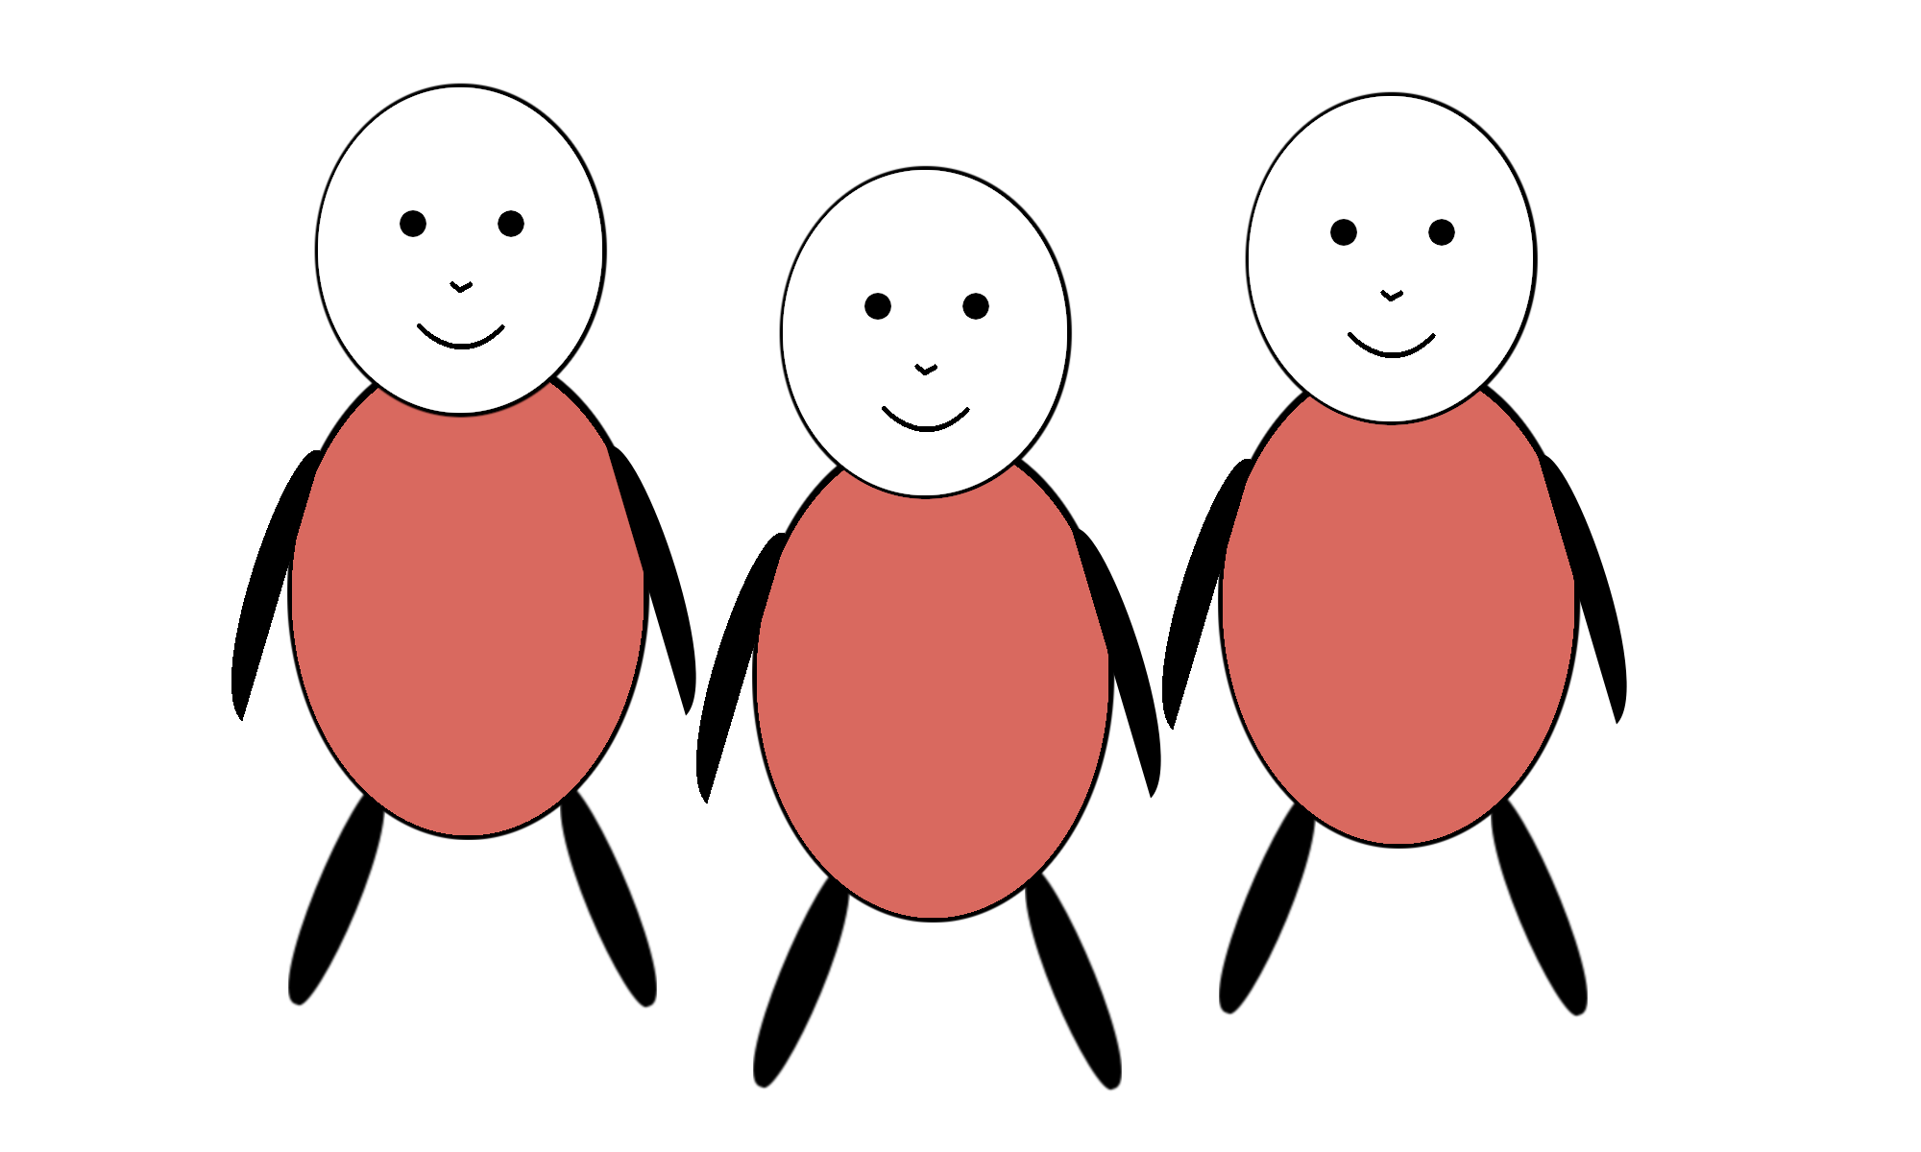
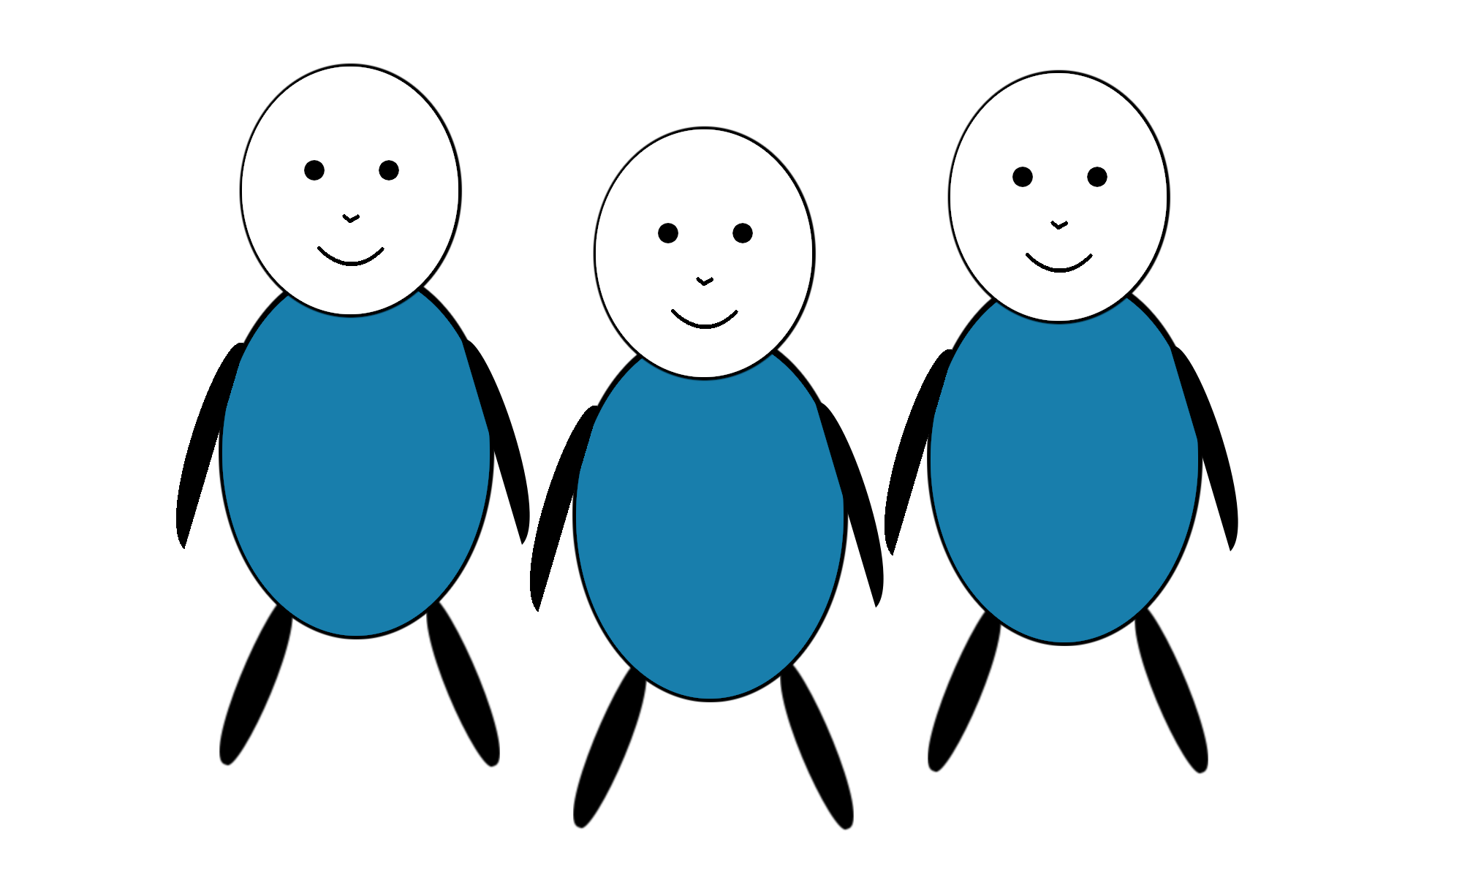
2a
Vawns work as terrafruit farmers.
Terrafruit are fruit that grow on bushes on islands in this area. Vawns go through bushes on the island to harvest terrafruit.
Vawns are paid a living wage for harvesting terrafruit. Harvesting terrafruit is a relatively low risk job.
Zarpies work as aquafruit farmers.
Aquafruit are fruit grow underwater off the coast of islands in this area.
Zarpies dive into the ocean near the island to harvest aquafruit. Zarpies are paid very little for harvesting aquafruit. Harvesting aquafruit can also be dangerous, because there are many sharks in the water.
occupation
Notes:
Distill down to

Slide 23
2b
Vawns work as grocers.
Vawns sell a variety of food on the island, including aquafruit and many other kinds of fruit and foods.
Vawns receive a living wage working as grocers. Working as a grocer is a relatively low risk job.
Zarpies work as aquafruit farmers.
Aquafruit are fruit grow underwater off the coast of islands in this area.
Zarpies dive into the ocean near the island to harvest aquafruit. Zarpies are paid very little for harvesting aquafruit. Harvesting aquafruit can also be dangerous, because there are many sharks in the water.
occupation
Notes:
Distill down to

Slide 24
occupation
Zarpies work as aquafruit farmers, and don't often work other jobs.
This is because Zarpies can hold their breath for a long time, their bodies are streamlined and powerfully built, and they have big hands and feet that are good for swimming, from even early in childhood. Their bodies are well-suited to farming aquafruit.
This is because Zarpies revere the ocean as a primordial source of life, consider growing aquafruit to be a sacred job that is their duty and destiny, and have passed down knowledge of how to farm aquafruit for generations. Their cultural values are well-suited to farming aquafruit.
This is because Zarpies are required by this island's government to fill out complex and expensive paperwork to be hired in other jobs, which limits economic opportunities for Zarpies. This situation leads Zarpies with little other choice than to farm aquafruit.
2a
2b
biology
culture
(shared beliefs/values)
structural
(constraints external to group)
Notes:
Distill down to

Slide 25
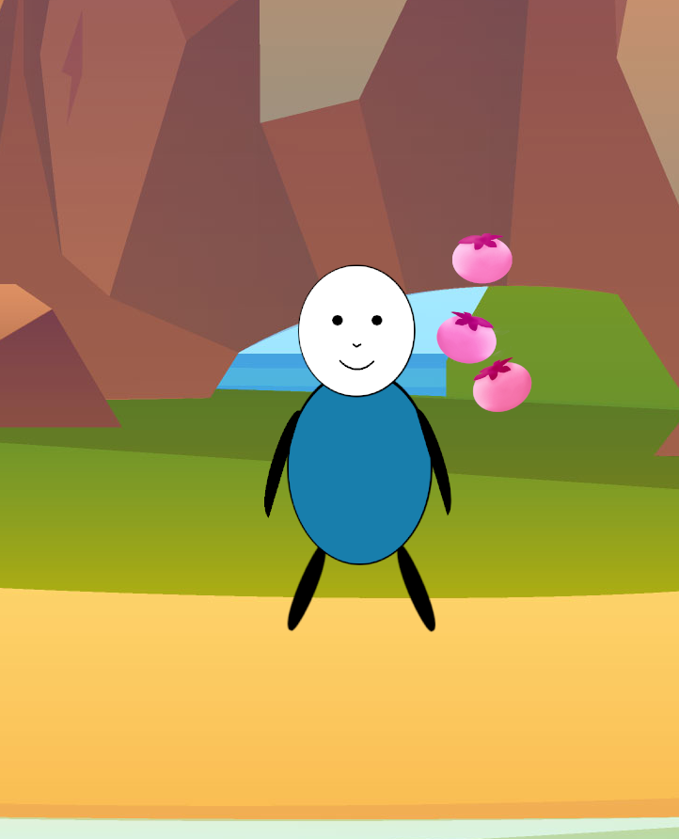
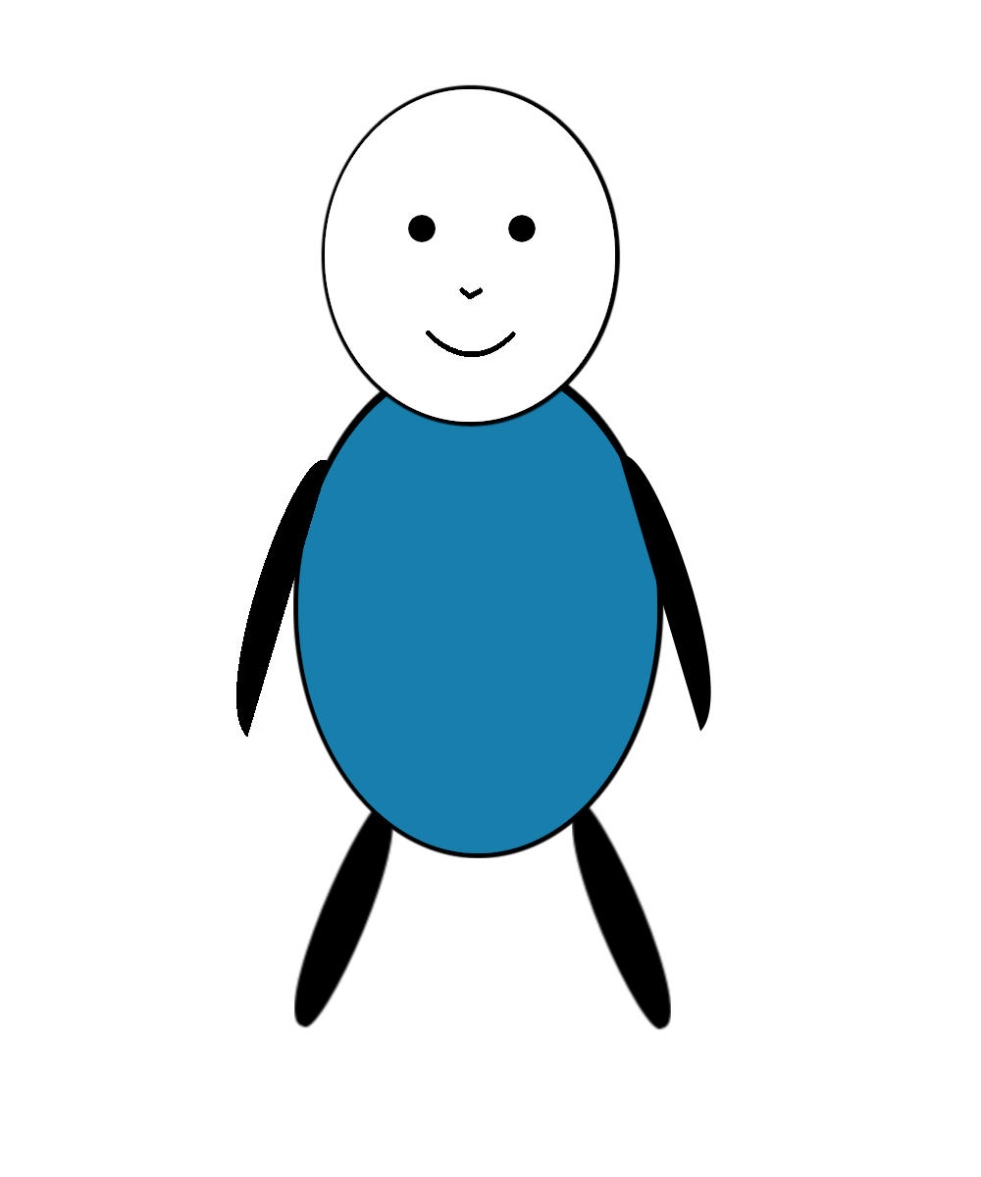

What are the consequences of different construals for occupation?
Possibility of change (gender stereotyping)
Possible for Zarpies to work the other job?
Which group usually work as terrafruit farmers /grocers? (Vawns)
Can/Could Zarpies also work as terrafruit farmers /grocers? (y/n x for sure/maybe)
Normativity (Roberts et al., 2016)
Disapprove if a Zarpie worked the other job?
Look, this Zarpie is working as a terrafruit farmer/grocer!
Is it okay or not okay for this Zarpie to work as a terrafruit farmer/grocer?
Generalization (switched context from essentialism)
Expect a Zarpie outside of the structural context to have same occupation?
This Zarpie does not live on the island we talked about. This Zarpie lives on a different island on the other side of the ocean, with a different government and different groups of people.
Which job do you think this Zarpie works?
Target of intervention
Oil spill destroyed aquafruit farms…
The island's government would like the Zarpies to become grocers this year.
If you could make anything happen, what would you do to get the Zarpies to work as grocers?
Notes:
cuisines develop & adapt to local ecology and resources

Slide 26
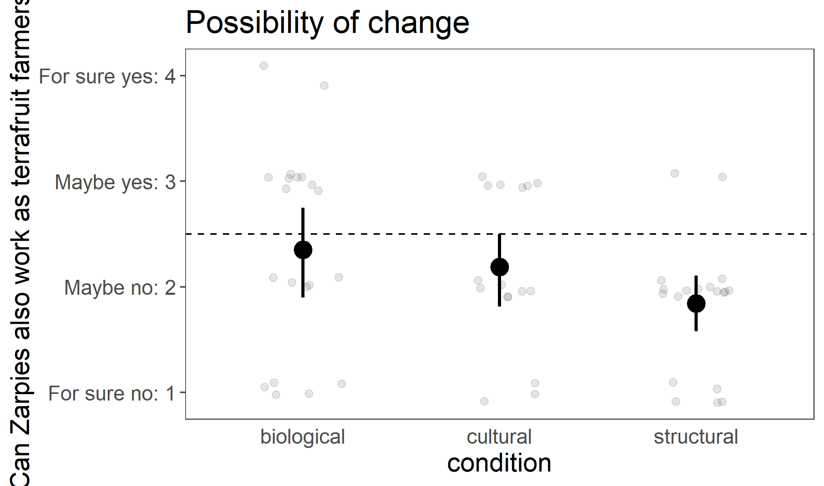
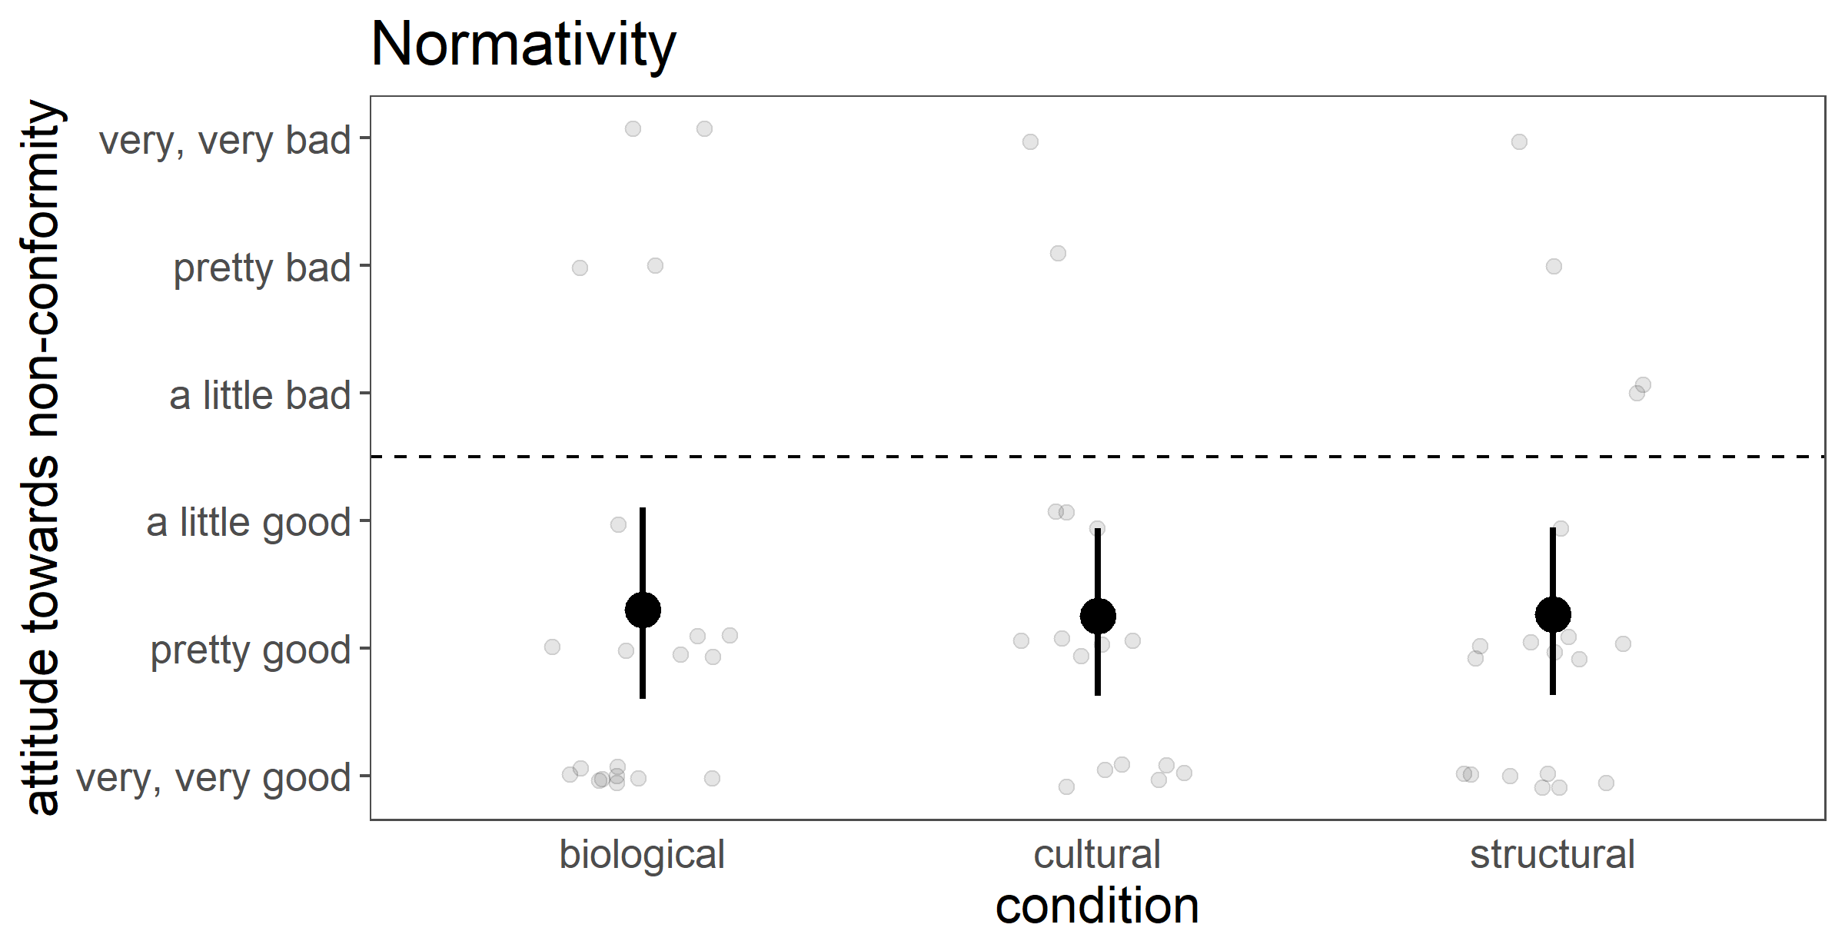
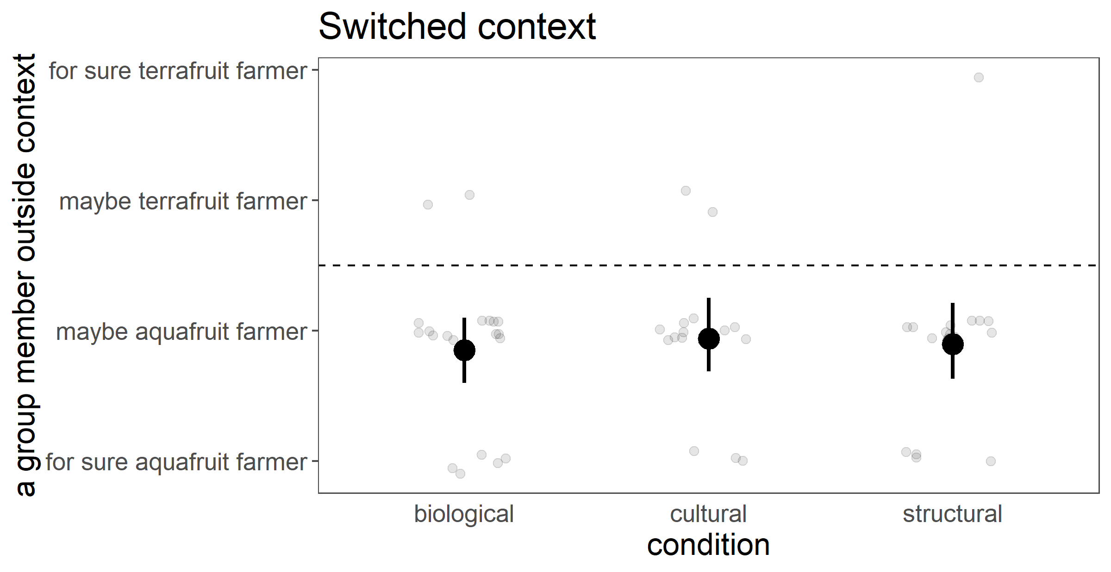
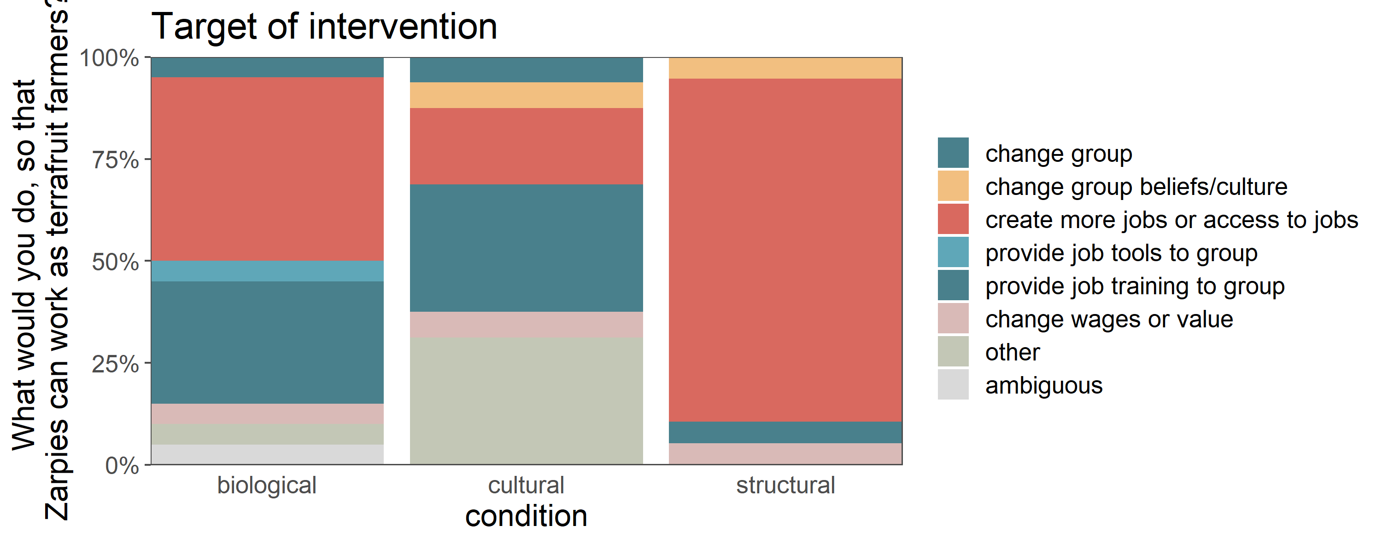
What are the consequences of different construals for occupation?
2a
adults (n=16-20/condition on MTurk)
Notes:
Pretty much everything except good old target of intervention was a wash
Target of intervention suggests ppts did process the manipulation
Possibility of change: “can” as right now given the current situation, is it possible to change – barriers in all cases, eg structural no bc paperwork
Normativity: valence washing out everything: positive attitudes towards someone who goes against their group to take the higher-paying, safer job → good they made it
Switched context: not surprised that biological and cultural predict same job, but surprised to see structural, - once you’re outside island gov, should be free of restrictions

Slide 27
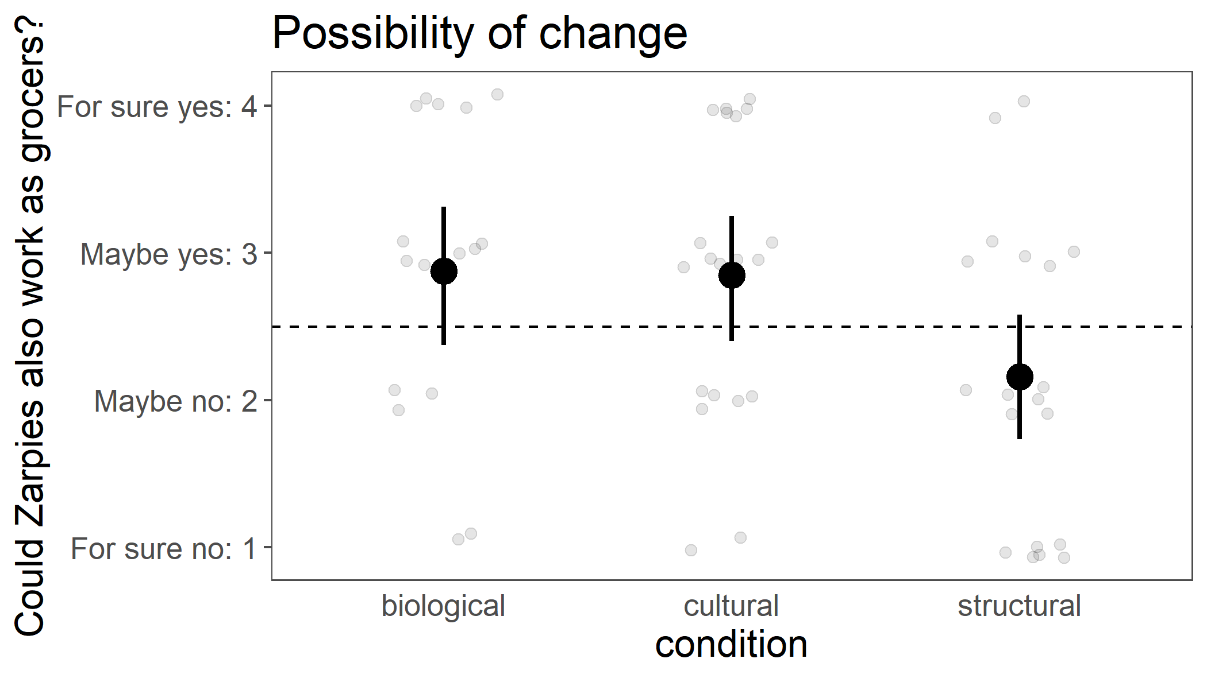
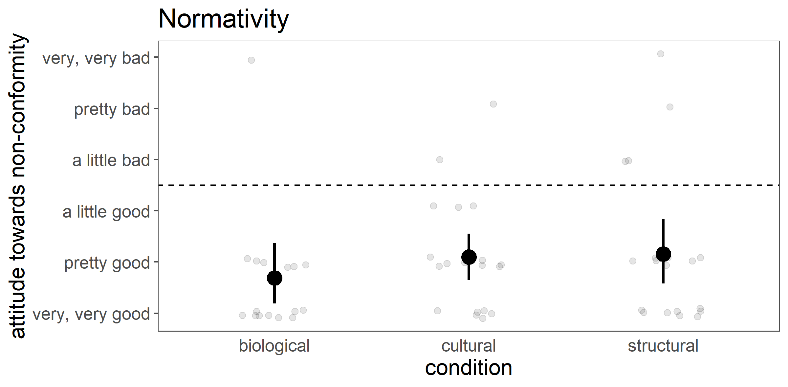
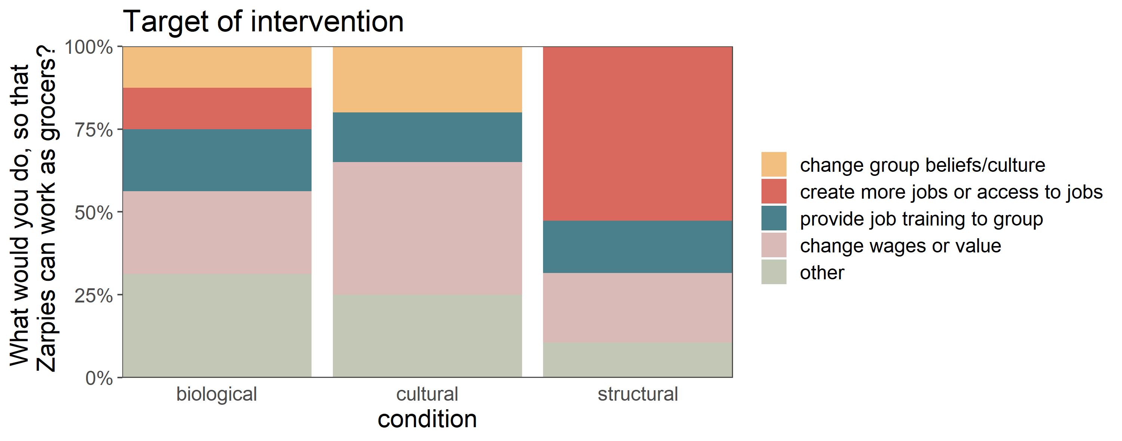
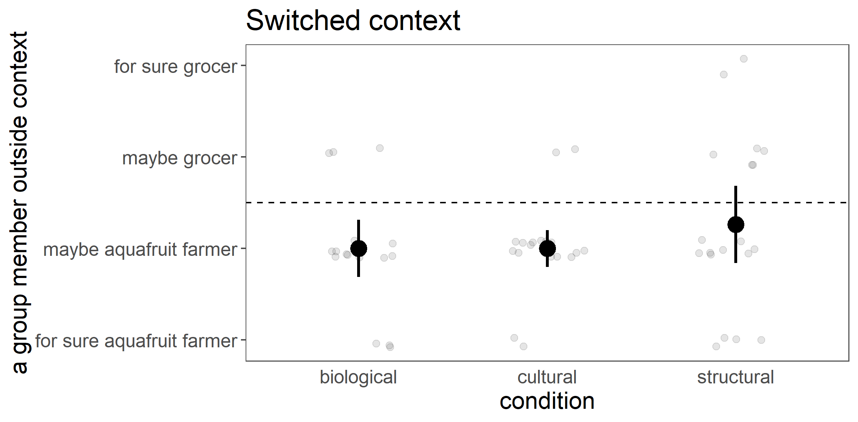
What are the consequences of different construals for occupation?
2b
adults (n=15-20/condition on MTurk)
Notes:
Same results 2b

Slide 28
Why does it matter which of these causes we attribute group properties/differences to?
essentialism
(Bailey et al, 2020)
biology
culture
(shared beliefs/values among group)
structural
(constraints on group external to group: eg access/availability)
- reduced blame for immoral behavior
group property
- wide group-based generalizations (stereotyping)
context-based generalizations (Vasilyeva et al, 2019/20)
properties seen as less central to group (Vasilyeva et al, 2020)
- increased perceived differences between groups?
- justifies properties as natural and normative?
Notes:
Were these measures capturing the consequence of interest? Are there other consequences of interest?

Slide 29
2c
Vawns work as managers at a food distributing company.
Vawns sell and ship a variety of food grown on the island, including aquafruit and many other kinds of fruit and foods.
Vawns earn a comfortable wage working as distribution managers. Working as a distribution manager is a relatively low risk job.
Zarpies work as aquafruit farmers.
Aquafruit are fruit grow underwater off the coast of islands in this area.
Zarpies dive into the ocean near the island to harvest aquafruit. Zarpies are paid very little for harvesting aquafruit. Harvesting aquafruit can also be dangerous, because there are many sharks in the water.
occupation
Notes:
Distill down to

Slide 30
occupation
Zarpies work as aquafruit farmers, and don't often work other jobs.
This is because Zarpies can hold their breath for a long time, their bodies are streamlined and powerfully built, and they have big hands and feet that are good for swimming, from even early in childhood. Their bodies are well-suited to farming aquafruit.
This is because Zarpies revere the ocean as a primordial source of life, consider growing aquafruit to be a sacred job that is their duty and destiny, and have passed down knowledge of how to farm aquafruit for generations. Their cultural values are well-suited to farming aquafruit.
This is because Zarpies are required by this island's government to fill out complex and expensive paperwork to be hired in other jobs, which limits economic opportunities for Zarpies. This situation leads Zarpies with little other choice than to farm aquafruit.
2b = 2c
biology
culture
(shared beliefs/values)
structural
(constraints external to group)
Notes:
Manipulation as 2b

Slide 31

What are the consequences of different construals for occupation?
Stability over time (future) (essentialism)
Will Zarpies always work as aquafruit farmers?
(for sure Y, probably Y,
probably N, for sure N)
Acceptability
Is it okay or not okay that Zarpies mostly work as aquafruit farmers and Vawns mostly work as distribution managers? (okay/not okay x 3 step)
Generalization (switched context from essentialism)
This Zarpie does not live on the island of Zarpies and Vawns. This Zarpie was born and raised on a different island country, with a different government and different groups of people. They live and work in that different island country.
Which job do you think this Zarpie works in their country? (for sure aquafruit farmer, probably, equally likely, probably, for sure dist. manager)
Group differences
Are Zarpies and Vawns more similar or more different from each other? (very similar, somewhat similar, equally similar and different, somewhat different, very different)
Target of intervention
The island government would like to get more Zarpies to work as distribution managers, rather than aquafruit farmers.
Notes:
3 new measures in randomized order
Stability over time: biology and cultural pretty stable, structural: depends on your optimism about social change haha
Acceptability: remember that current situation involves poor wages vs comfortable wages, dangerous vs safe job
Group differences: essentialism amplifies between-group differences, exploratory see what structural would look like: case for not that different, they’re just treated differently by the gov, but on the other hand, experiences of privilege and discrimination can be meaningful differences
Generalization: make it super clear that they were born and raised in that different country, hope that people don’t generalize in structural case

Slide 32
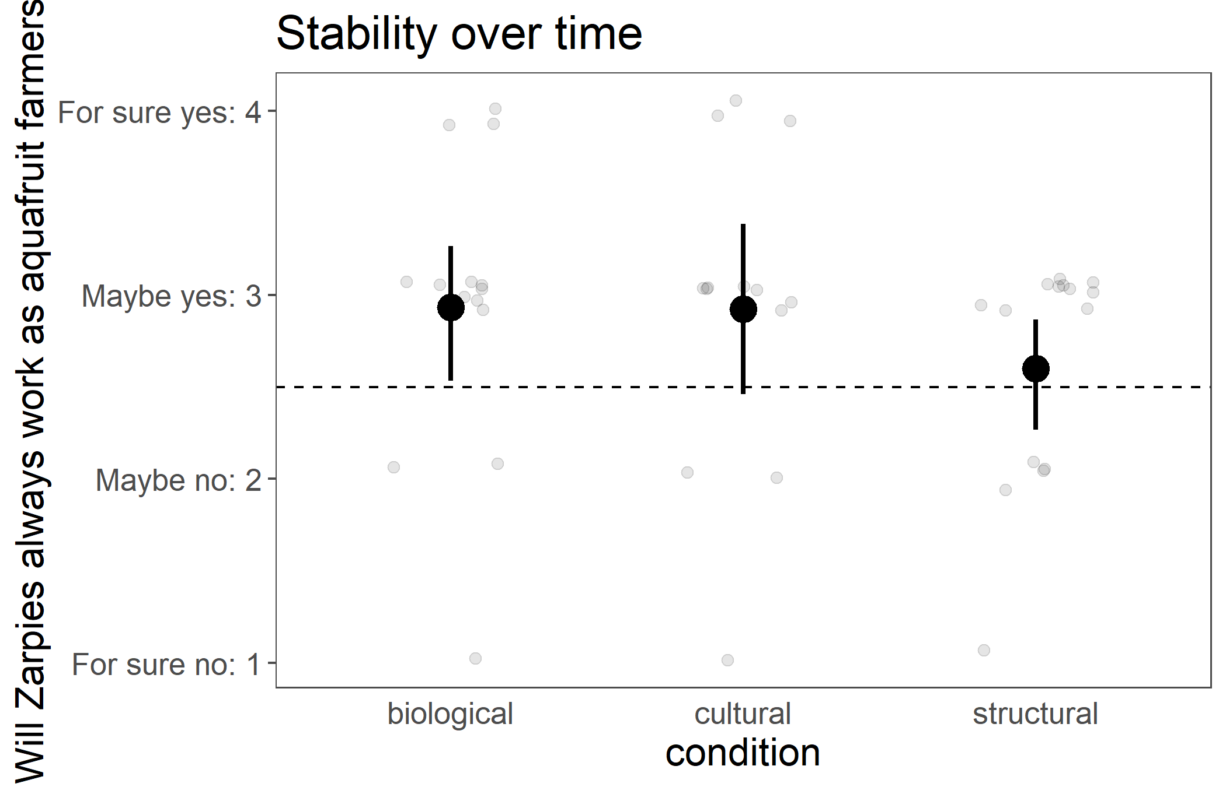
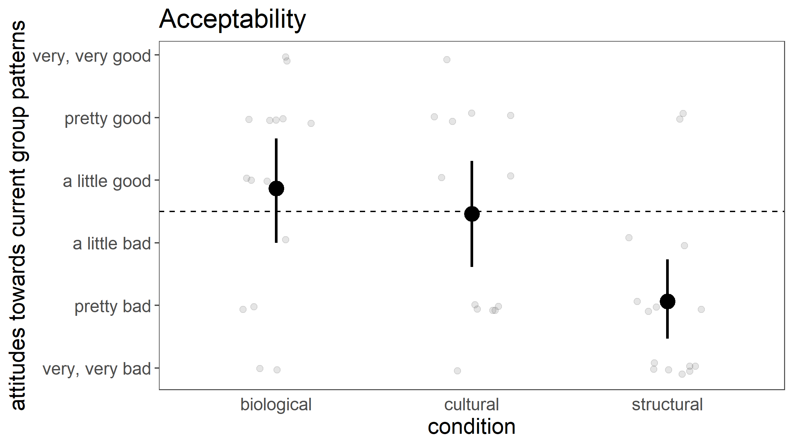
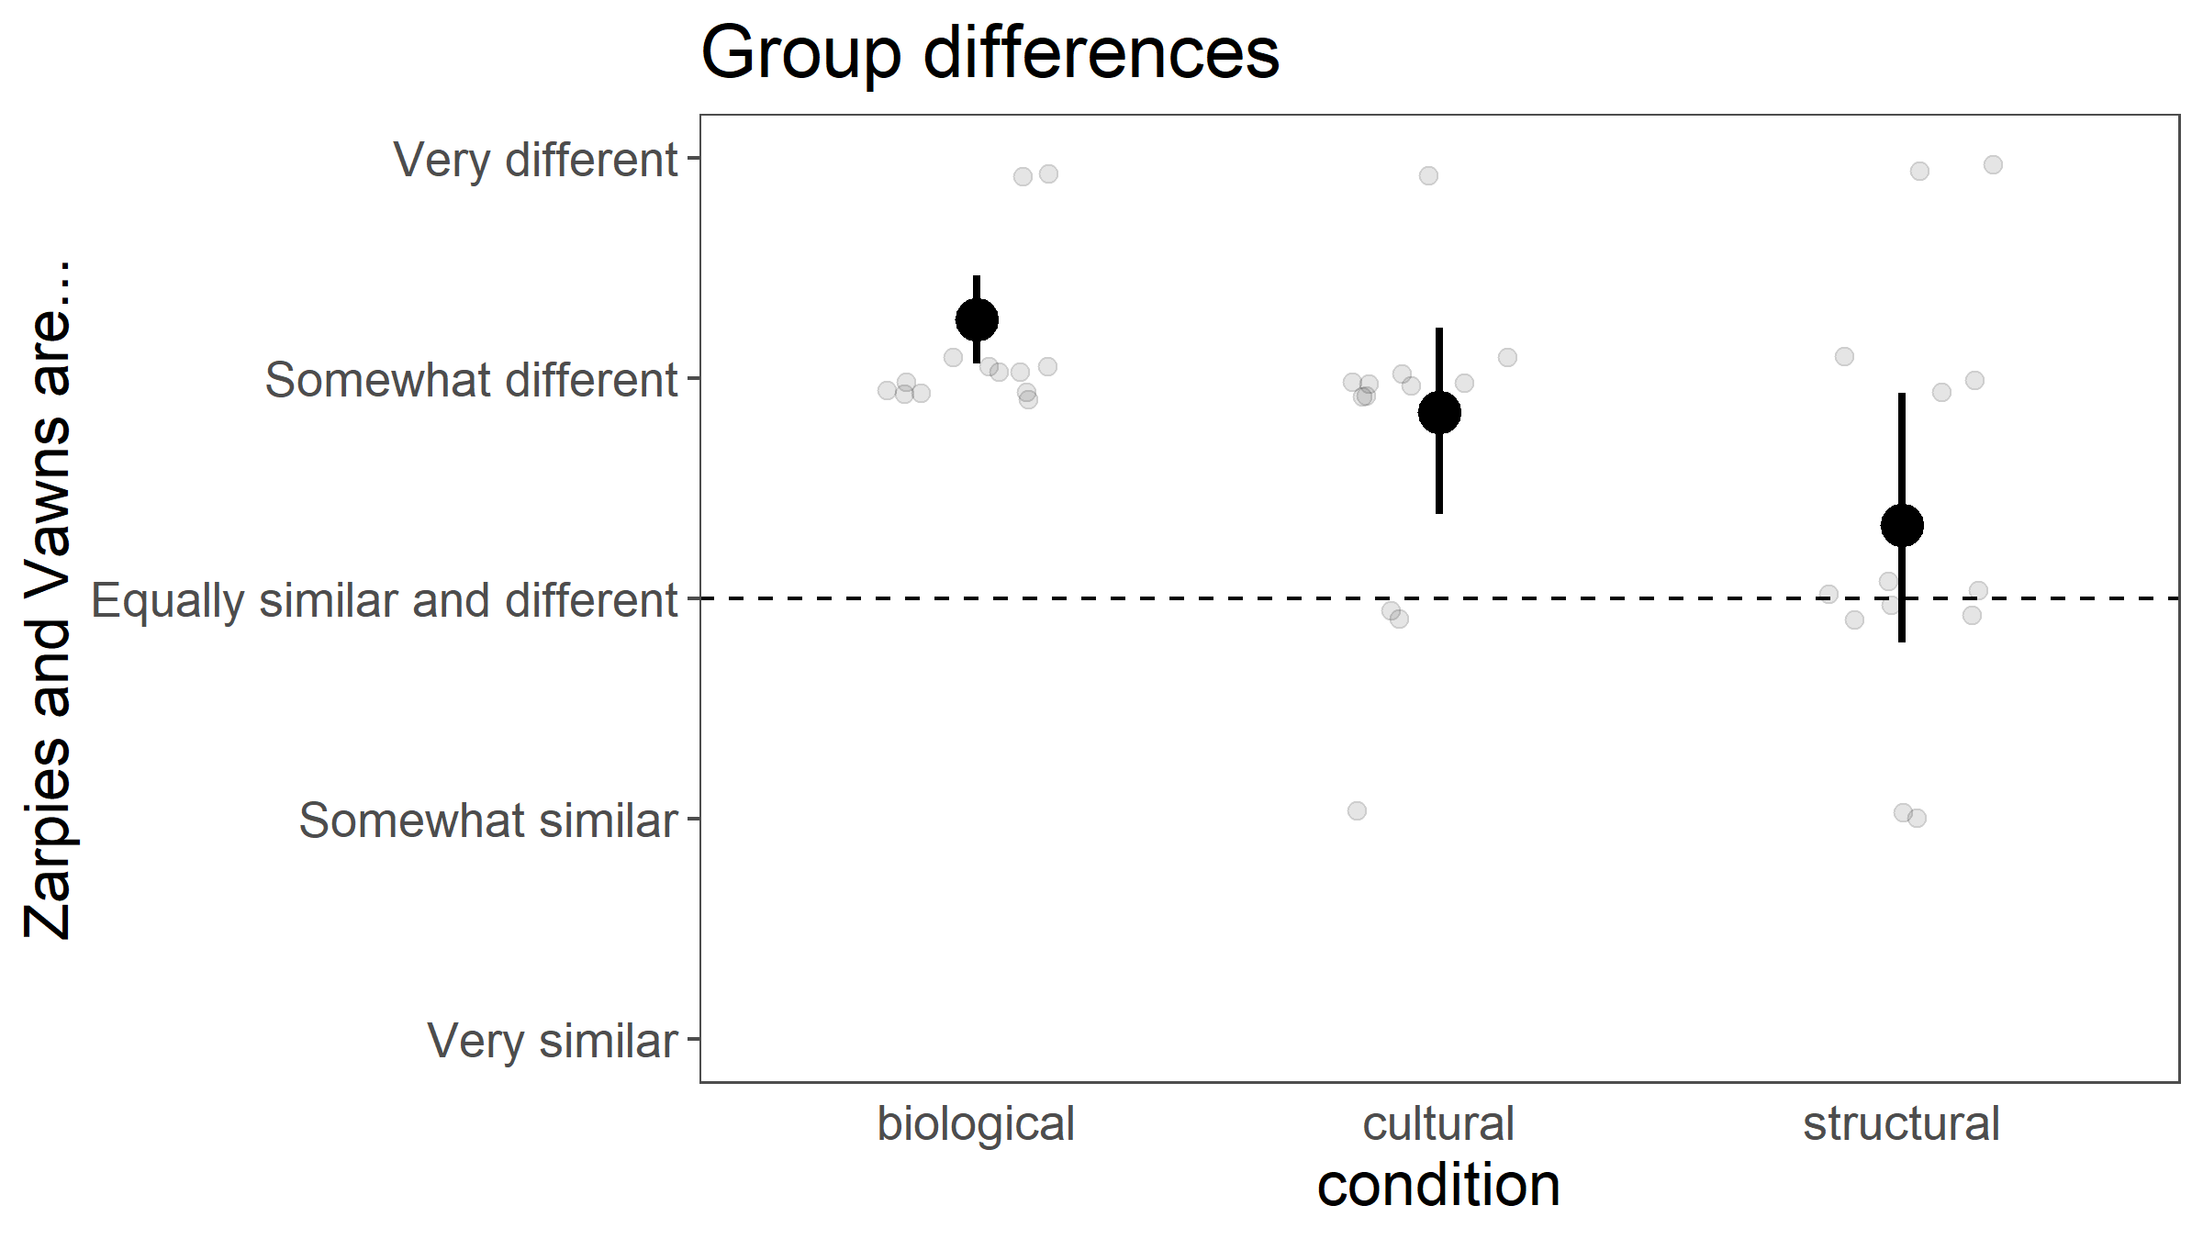
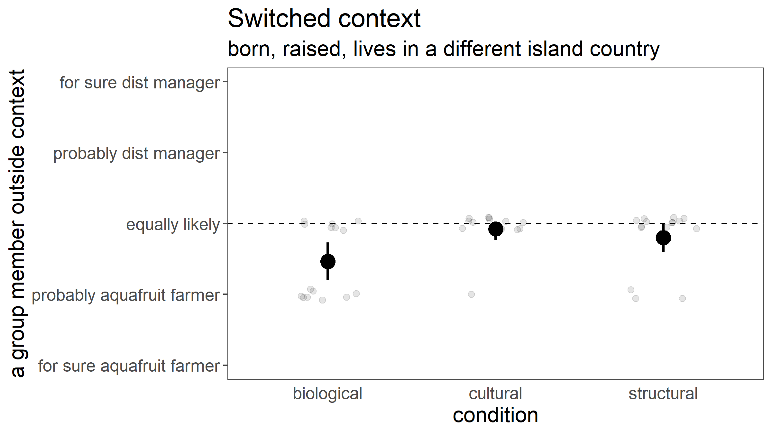
What are the consequences of different construals for occupation?
adults (n=13-25/condition on MTurk)
2c

